Slide 1
What’s new in Azure Machine Learning?
Marcel Franke

Slide 2





Short Introduction - Marcel
https://github.com/marcelfranke
https://www.linkedin.com/in/marcelfranke/
marcel.franke@microsoft.com

Slide 3
Where did it all start?

Slide 4
Microsoft Research
Turning ideas into reality for 27 years
MSR Cambridge
MSR Redmond
MSR Montreal
MSR New York
MSR New England
MSR Beijing
MSR Shanghai
MSR India
8
MSR Labs
1k+
Researchers
20+
Fields
4k+
WW Patents
22k+
Papers
Notes:
27 years ago, we created MS Research – began INVESTING in BUILDING BLOCKS of AI
8 LABS across GLOBE w/over 1K RESEARCHERS shaping NEXT GEN OF AI
Publishing 22K+ research papers since inception of MSR
3.5K papers are Artificial Intelligence
Why SO important:
Advance slide

Slide 5







Driving innovation
Fueled by breakthrough research
MSR Cambridge
MSR Redmond
MSR Montreal
MSR New York
MSR New England
MSR Beijing
MSR Shanghai
MSR India
Switchboard
Meeting speech
Broadcast speech
Switchboard cellular
IBM Switchboard
First FPGA deployed in a datacenter
Speech recognition human parity
Machine translation human parity
Conversational Q&A human parity
Object detection human parity
39.5 Teraflops with Intel Stratix 10
94.9% on Switchboard test
69.9% with MT Research system
89.4% on Stanford CoQA test
96% on RESNET vision test
Notes:
ALL THIS WORK led to EXPLOSION of AI Breakthroughs from Microsoft Research in past couple of years
We continue to advance AI in all areas.
Speech: Computers have begun learning to see like us, but now they're learning to listen and recognize speech like us, too. Microsoft became the first to reach human parity in speech recognition with the Switchboard dataset. This goal seemed very distant just a few years ago.
Language: The world has more than 6,500 languages. With speech advancements, we are also making gains in natural language. Microsoft Translator can now support more than 60 languages and we just recently announced that we reached human parity in English to Chinese and Chinese to English machine translation with the WMT benchmark.
Knowledge: We’re now getting to the point where computers can do some of what people can do: see, hear, and begin to attach words to the world around them. And we’re not just talking perception, but cognition too. Microsoft Research Asia created a technology that beat a reading comprehension test built at Stanford. We’re continuing to build on that program to advance how AI connects ideas and concepts to the people, places, and things in the world around us.
Computer Vision: Microsoft has won many awards in image recognition competitions like ImageNet 1K. This was accomplished by training neural networks with a depth of 152 layers with the RESNET test. These deep residual nets give us much greater accuracy to correctly identify images over 96% of the time. DenseNet is the next innovation in this area.

Slide 6

Azure Artificial Intelligence
Pre-built AI models
Azure Cognitive Services
Custom AI models
Azure Machine Learning
Notes:
You can infuse AI into your applications with Azure:
Using pre-trained AI models that we have built and that can be easily customized with your data.
You can also build custom AI models using our Azure Machine Learning service.
Azure Machine Learning
In addition to using our pre built Azure AI models, you can also use our Azure Machine Learning service to build, train and deploy custom machine learning models at scale.
You can access Azure Machine Learning service from your favorite Python development environment, including Visual Studio Code, Visual Studio, PyCharm, Azure Databricks notebooks, or Jupyter notebooks.
Azure Machine Learning enables you to use your framework of choice including TensorFlow, PyTorch and Kerras and train on massive, managed GPU clusters.
Our new MLOps capability simplifies the end-to-end lifecycle machine of ML models. You can think of it like DevOps for ML. It helps you automate all of the steps from model creation to deployment and monitoring with Azure DevOps integration.

Slide 7
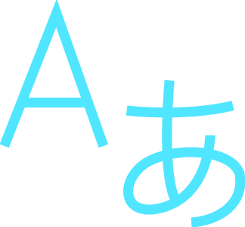






Machine Learning on Azure
Domain specific pretrained models
To simplify solution development
…
Vision
Speech
Language
Web search
Decision
Familiar Data Science tools
To simplify model development
Visual Studio Code
Azure Notebooks
Jupyter
Command line
Popular frameworks
To build advanced deep learning solutions
PyTorch
TensorFlow
Scikit-Learn
ONNX
Productive services
To empower data science and development teams
Azure Machine Learning
Azure Databricks
Machine Learning VMs
Powerful infrastructure
To accelerate deep learning
CPU
GPU
FPGA
From the Intelligent Cloud to the Intelligent Edge

Slide 8
Azure Machine Learning

Slide 9
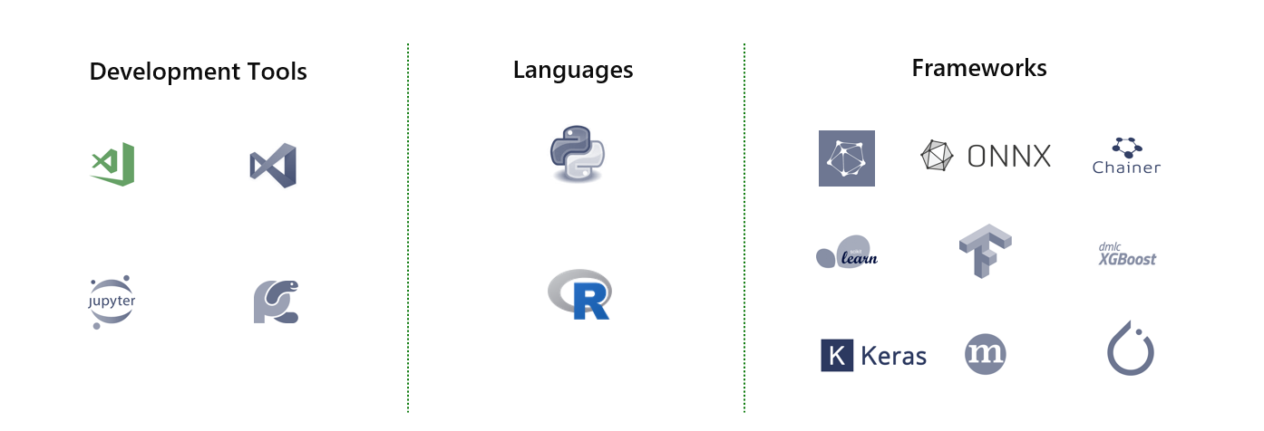
Azure Machine Learning
Open and interoperable

Slide 10

Azure Machine Learning service
Simplified machine learning
End to end lifecycle management
Open platform

Slide 11

Azure Machine Learning components
Experience
SDK, Notebooks, Drag-n-drop, Wizard
MLOps
Reproducible, Automatable, GitHub, CLI, REST
Datasets
Profiling, Drift, Labeling
Training
Experiments, Runs
Model Registry
Models, Images
Inferencing
Batch, Realtime
Compute
Jobs, Clusters, Instances
IoT Edge
Security, Mgmt, Deployment
Cloud
CPU, GPU, FPGA
Edge
CPU, GPU, NPU

Slide 12



Open platform
Native MLflow support
ONNX Runtime updates
Azure Open Datasets

Slide 13
Demo
Azure Machine Learning
Notes:
Demo old Experience in Azure Portal

Slide 14
What’s new?

Slide 15
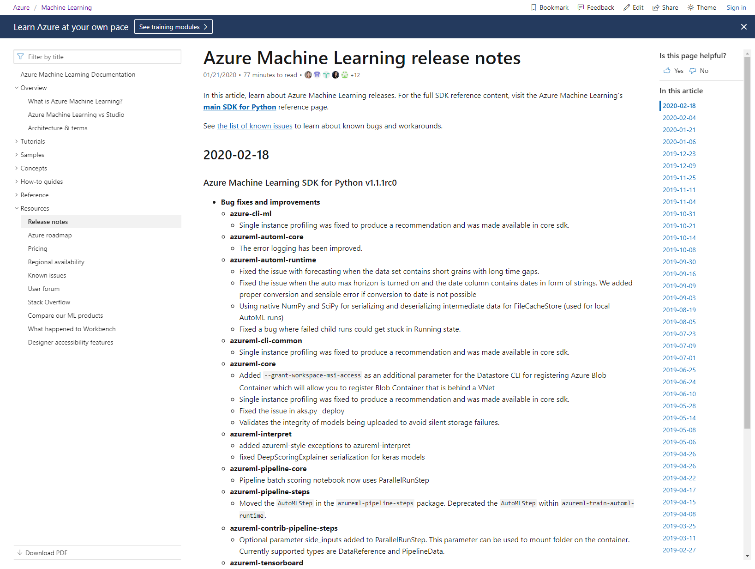

Slide 16
Functionality
Highlights
Integration
Enterprise Ready
Studio
Designer
Datasets
Pipelines
Notebooks
Auto ML
Labeling
R SDK
Databricks
mlflow
Visual Studio Code
Event Grid
Power BI
Open Datasets
Interpretability
RBAC
VNET
Monitoring
MLOps
Pricing

Slide 17
Functionality

Slide 18
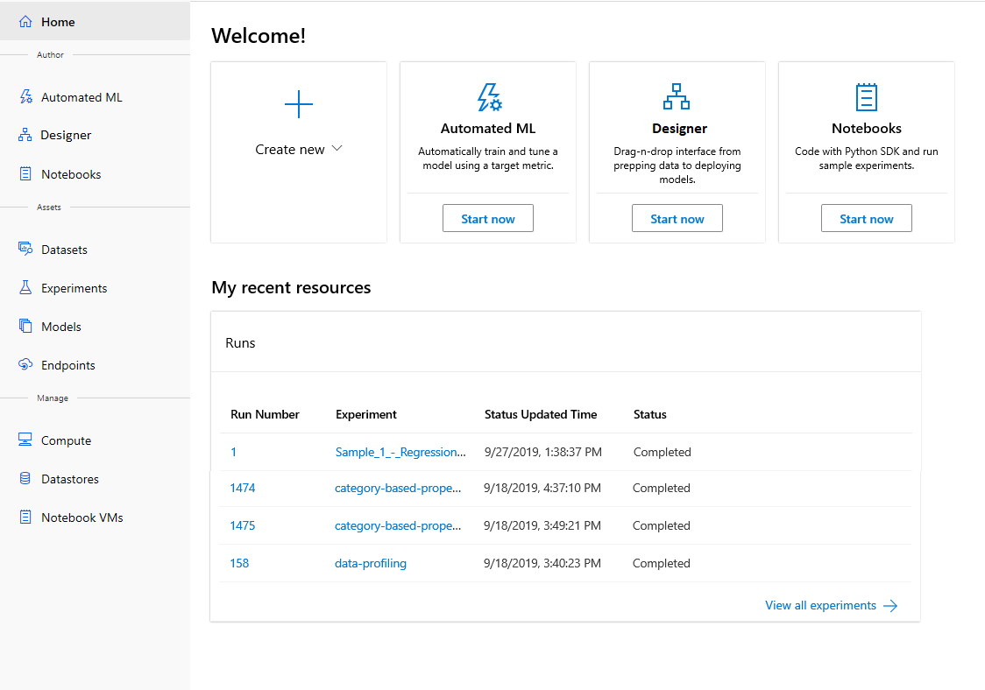
Azure Machine Learning
ML for all skill levels
Notes:
We’ve received a lot of feedback from enterprise customers that their data scientists and developers prefer to develop and work in web-based (or SaaS like) experiences. The Azure portal does not meet the needs – it is complex and focused largely on streamlining the IT experience. Data Scientists want better separation to focus on the tasks that are important to them and so we have built a dedicated portal to accommodate their needs.
This web experience, called the Azure Machine Learning studio, brings together data science capabilities and ML assets into a single web pane that streamlines machine learning workflows. The Enterprise edition caters to data scientists across diverse skill levels from no-code authoring to code-first experiences. You can access the new studio at https://ml.azure.com.

Slide 19
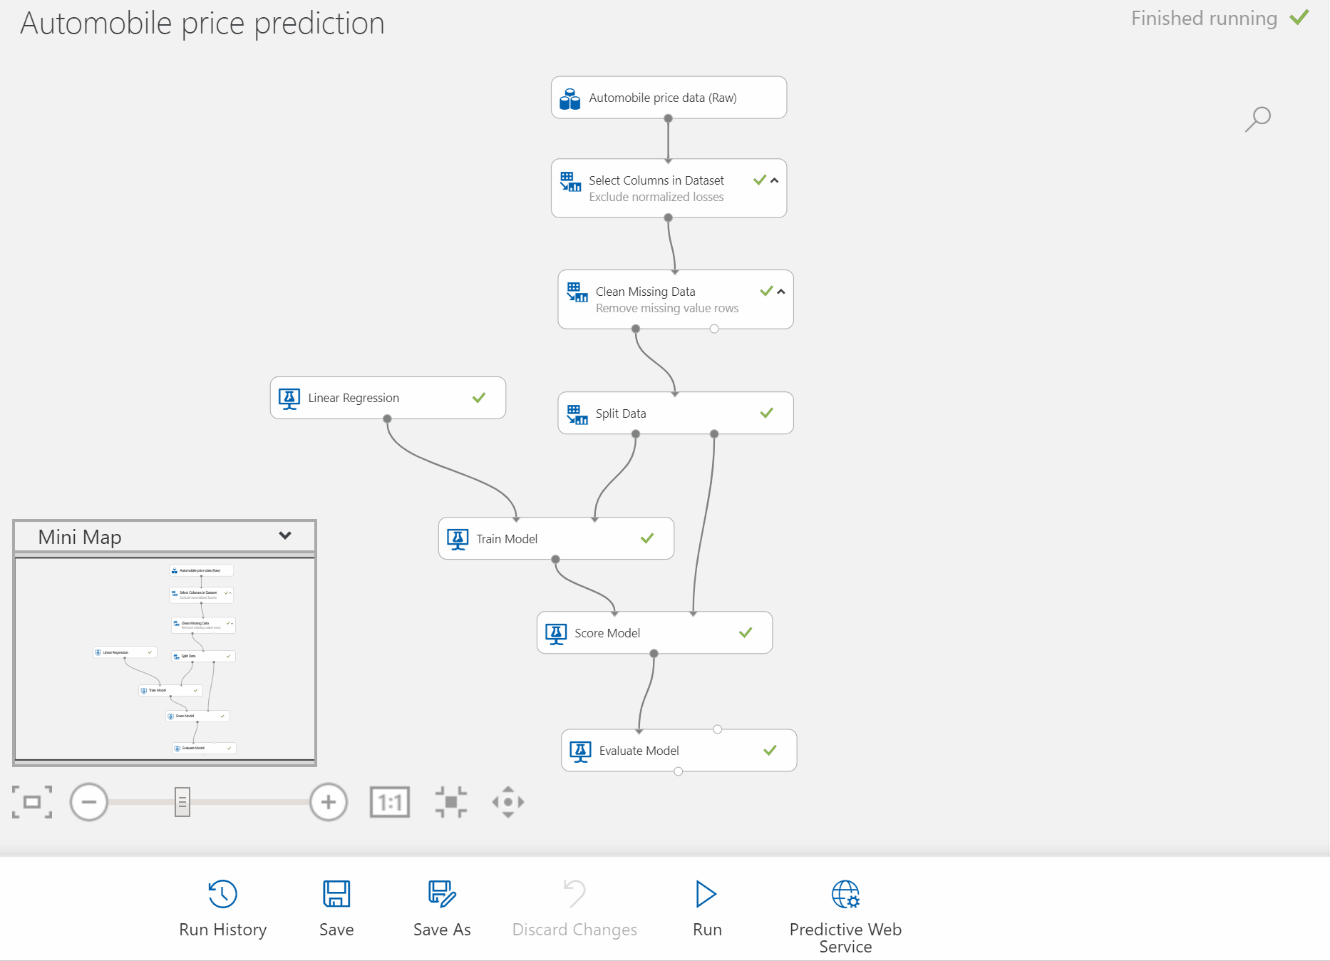
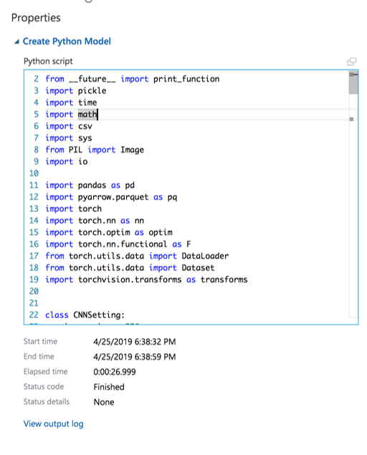
Drag and drop modeling with designer
User built in modules, data visualization, model evaluation
Automatically generate scoring files, register models and build images using AKS for scale
Custom code to run Python and R

Slide 20
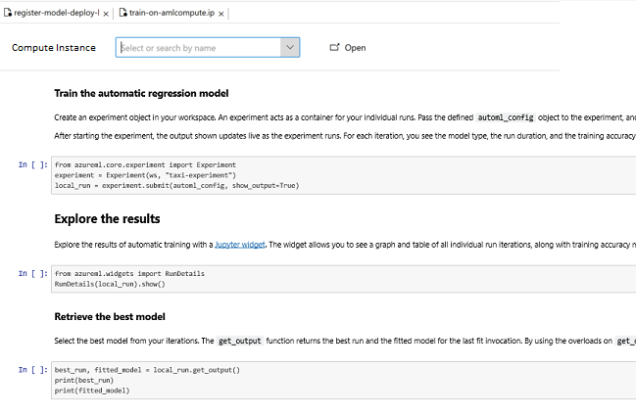
Code-first ML with Notebooks
Build and deploy models easily using integrated notebooks and popular tools. Collaboratively debug models and share notebooks within the boundaries of workspace.
Broad support for Azure VM types and persisted low-level customization makes advanced scenarios
Pre-configured environment with up-to-date ML packages, GPU drivers and everything Data Scientists need to save time on setup tasks.

Slide 21
Demo
Studio, Designer, Notebooks

Slide 22
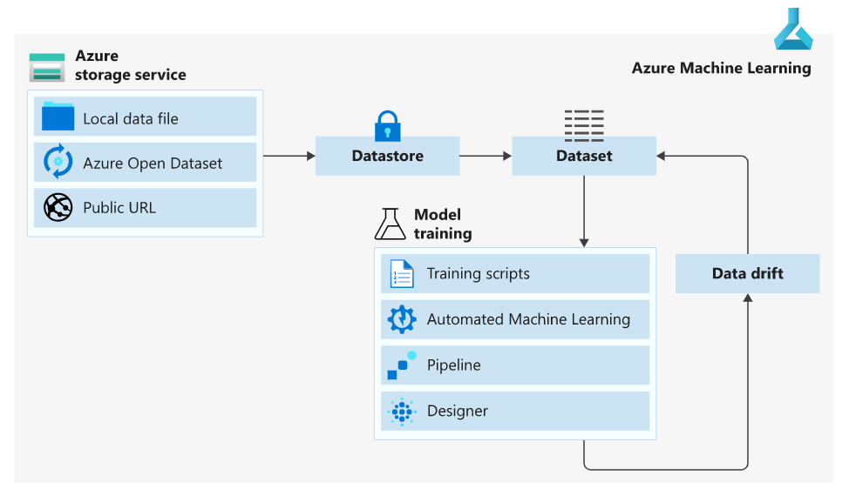
Datasets
Easily connect with your data

Slide 23
Demo
Datasets & Data drift

Slide 24
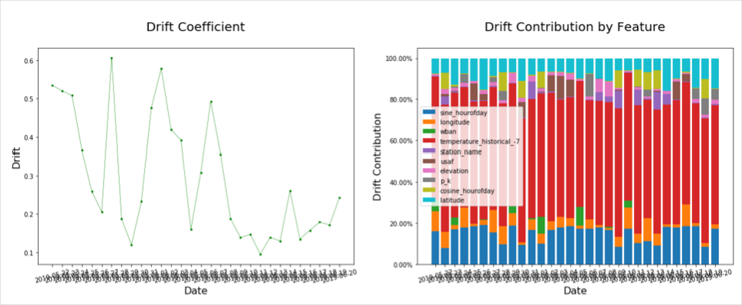
Data Drift Monitoring
Monitor Data Drift on deployed models

Slide 25
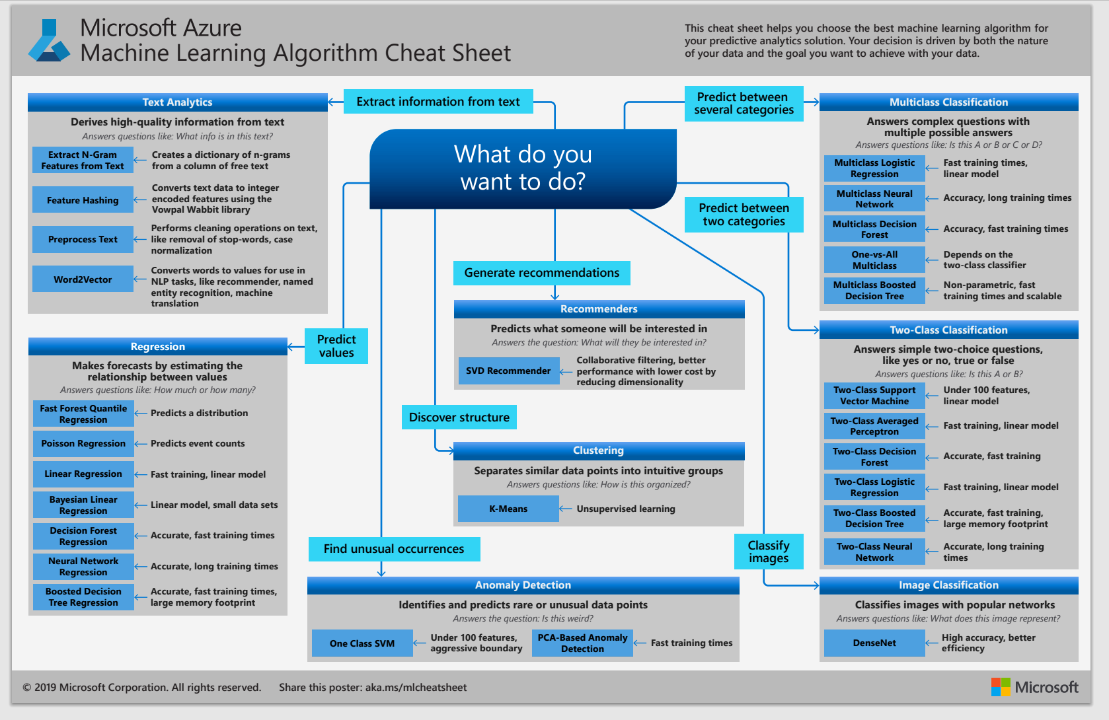

Slide 26
Azure Machine Learning
Automated machine learning
How much is this car worth?

Slide 27
Model creation is typically a time-consuming process
Which features?
Which algorithm?
Which parameters?
Mileage
Condition
Car brand
Year of make
Regulations
…
Gradient Boosted
Nearest Neighbors
SVM
Bayesian Regression
LGBM
…
Parameter 1
Parameter 2
Parameter 3
Parameter 4
…
Mileage
Gradient Boosted
Criterion
Loss
Min Samples Split
Min Samples Leaf
Others
Car brand
Year of make
30%
Model
Notes:
https://docs.microsoft.com/en-us/azure/machine-learning/concept-automated-ml
Model Score of 30%

Slide 28
Model creation is typically a time consuming process
Which features?
Which algorithm?
Which parameters?
Mileage
Condition
Car brand
Year of make
Regulations
…
Gradient Boosted
Nearest Neighbors
SVM
Bayesian Regression
LGBM
…
Criterion
Loss
Min Samples Split
Min Samples Leaf
Others
Mileage
Gradient Boosted
N Neighbors
Weights
Metric
P
Others
Condition
Nearest Neighbors
Car brand
Car brand
50%
30%
Year of make
Year of make
Model
Iterate

Slide 29
Model creation is typically a time consuming process
Which features?
Which algorithm?
Which parameters?
30%
50%
70%
30%
45%
50%
65%
95%
35%
10%
75%
20%
70%
30%
15%
Iterate

Slide 30
Azure Machine Learning accelerates model selection
with automated machine learning
Input
Intelligently test multiple models in parallel
Output
25%
Optimized model
25%
40%
Enter data
70%
25%
40%
70%
95%
95%
Define goals
25%
40%
70%
25%
40%
25%
70%
Apply constraints
40%

Slide 31
Demo
Auto ML

Slide 32
Supported Algorithms
Classification | Regression | Time Series Forecasting
Logistic Regression | Elastic Net | Elastic Net
Light GBM | Light GBM | Light GBM
Gradient Boosting | Gradient Boosting | Gradient Boosting
Decision Tree | Decision Tree | Decision Tree
K Nearest Neighbors | K Nearest Neighbors | K Nearest Neighbors
Linear SVC | LARS Lasso | LARS Lasso
Support Vector Classification (SVC) | Stochastic Gradient Descent (SGD) | Stochastic Gradient Descent (SGD)
Random Forest | Random Forest | Random Forest
Extremely Randomized Trees | Extremely Randomized Trees | Extremely Randomized Trees
Xgboost | Xgboost | Xgboost
DNN Classifier | DNN Regressor | DNN Regressor
DNN Linear Classifier | Linear Regressor | Linear Regressor
Naive Bayes | Fast Linear Regressor | Auto-ARIMA
Stochastic Gradient Descent (SGD) | Online Gradient Descent Regressor | Prophet
Averaged Perceptron Classifier |  | ForecastTCN
Linear SVM Classifier

Slide 33
Data Preprocessing
data is automatically scaled or normalized to help algorithms perform well
Automatic Preprocessing
Advanced Preprocessing
Scaling & normalization | Description
StandardScaleWrapper | Standardize features by removing the mean and scaling to unit variance
MinMaxScalar | Transforms features by scaling each feature by that column’s minimum and maximum
MaxAbsScaler | Scale each feature by its maximum absolute value
RobustScalar | This Scaler features by their quantile range
PCA | Linear dimensionality reduction using Singular Value Decomposition of the data to project it to a lower dimensional space
TruncatedSVDWrapper | This transformer performs linear dimensionality reduction by means of truncated singular value decomposition (SVD). Contrary to PCA, this estimator does not center the data before computing the singular value decomposition, which means it can work with scipy.sparse matrices efficiently
SparseNormalizer | Each sample (that is, each row of the data matrix) with at least one non-zero component is rescaled independently of other samples so that its norm (l1 or l2) equals one
Preprocessing steps | Description
Drop high cardinality or no variance features | Drop these from training and validation sets, including features with all values missing, same value across all rows or with extremely high cardinality (for example, hashes, IDs, or GUIDs).
Impute missing values | For numerical features, impute with average of values in the column. For categorical features, impute with most frequent value.
Generate additional features | For DateTime features: Year, Month, Day, Day of week, Day of year, Quarter, Week of the year, Hour, Minute, Second. For Text features: Term frequency based on unigrams, bi-grams, and tri-character-grams.
Transform and encode | Numeric features with few unique values are transformed into categorical features. One-hot encoding is performed for low cardinality categorical; for high cardinality, one-hot-hash encoding.
Word embeddings | Text featurizer that converts vectors of text tokens into sentence vectors using a pre-trained model. Each word’s embedding vector in a document is aggregated together to produce a document feature vector.
Target encodings | For categorical features, maps each category with averaged target value for regression problems, and to the class probability for each class for classification problems. Frequency-based weighting and k-fold cross validation is applied to reduce over fitting of the mapping and noise caused by sparse data categories.
Text target encoding | For text input, a stacked linear model with bag-of-words is used to generate the probability of each class.
Weight of Evidence (WoE) | Calculates WoE as a measure of correlation of categorical columns to the target column. It is calculated as the log of the ratio of in-class vs out-of-class probabilities. This step outputs one numerical feature column per class and removes the need to explicitly impute missing values and outlier treatment.
Cluster Distance | Trains a k-means clustering model on all numerical columns. Outputs k new features, one new numerical feature per cluster, containing the distance of each sample to the centroid of each cluster.

Slide 34
Azure Machine Learning pipelines
Prepare data
Build & train models
Deploy & predict
Data Preparation
Model building & training
Model deployment
Data ingestion
Normalization
Hyper-parameter tuning
Deployment
Transformation
Automatic model selection
Batch scoring
Validation
Model testing
Data storage locations
Featurization
Model validation

Slide 35
Integration

Slide 36
Databricks Integration
Customers who use Azure Databricks for advanced analytics can now use the same cluster to run experiments with or without automated machine learning
Databricks as a Compute Target from AML Pipelines

Slide 37
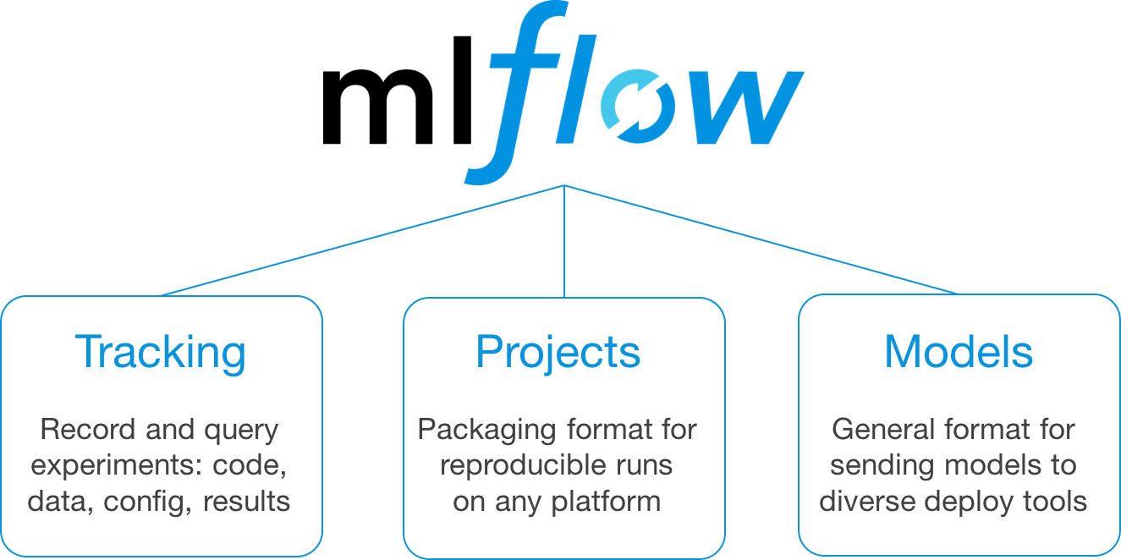
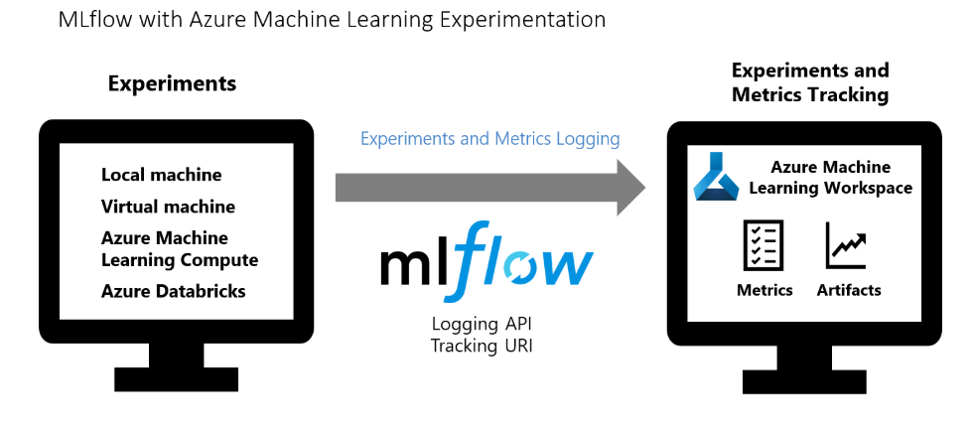
Integration with mlflow

Slide 38
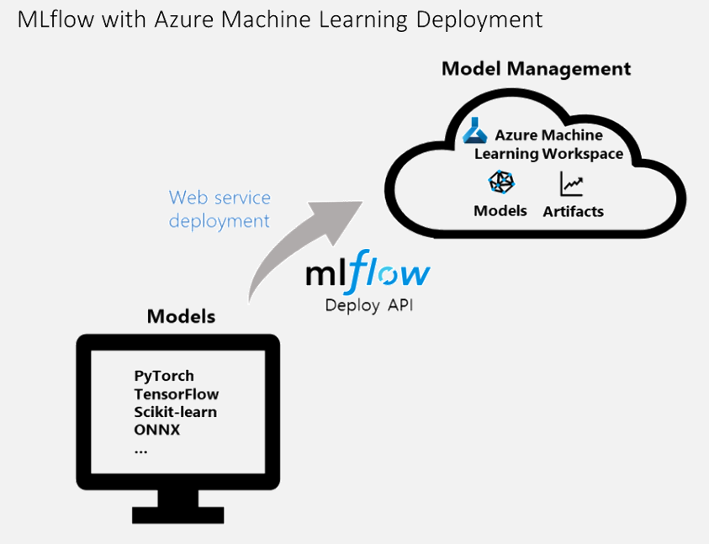
Integration with mlflow
 | MLflow Tracking | Azure Machine Learning Python SDK | Azure Machine Learning CLI | Azure Machine Learning Studio
Manage workspace |  | ✓ | ✓ | ✓
Use data stores |  | ✓ | ✓
Log metrics | ✓ | ✓
Upload artifacts | ✓ | ✓
View metrics | ✓ | ✓ | ✓ | ✓
Manage compute |  | ✓ | ✓ | ✓

Slide 39
Demo
mlflow Integration
Notes:
https://mlflow.org/docs/latest/python_api/index.html

Slide 40
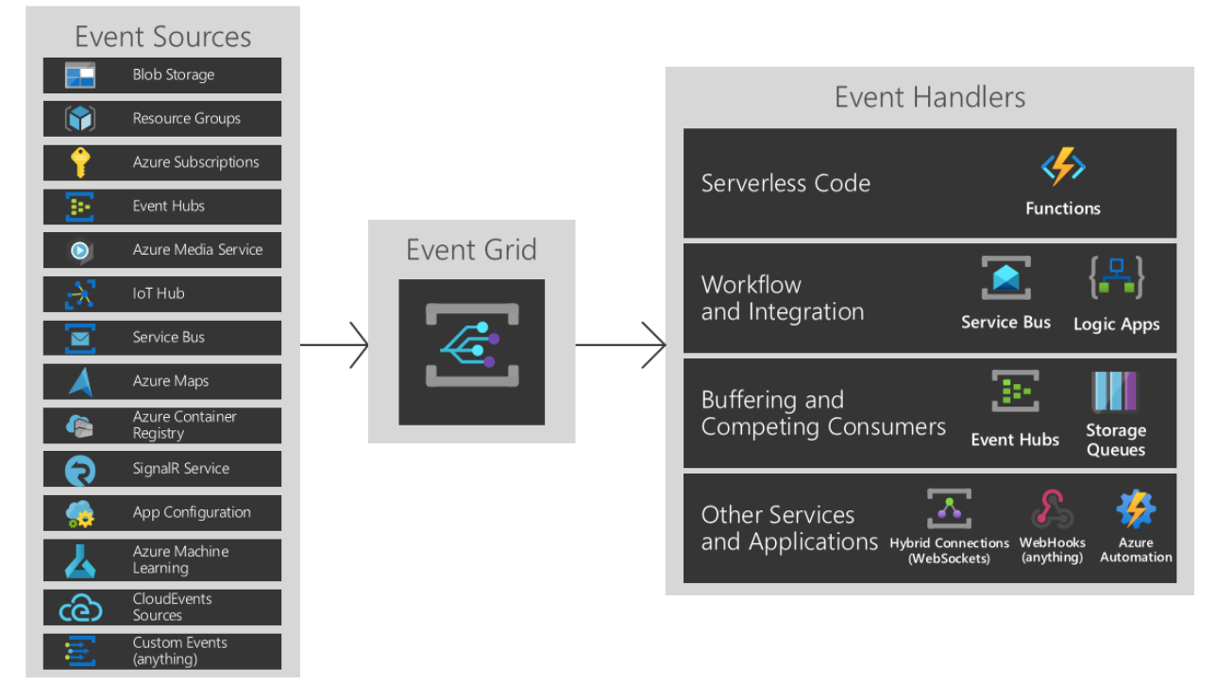
Event Grid Integration

Slide 41
Enterprise Ready

Slide 42
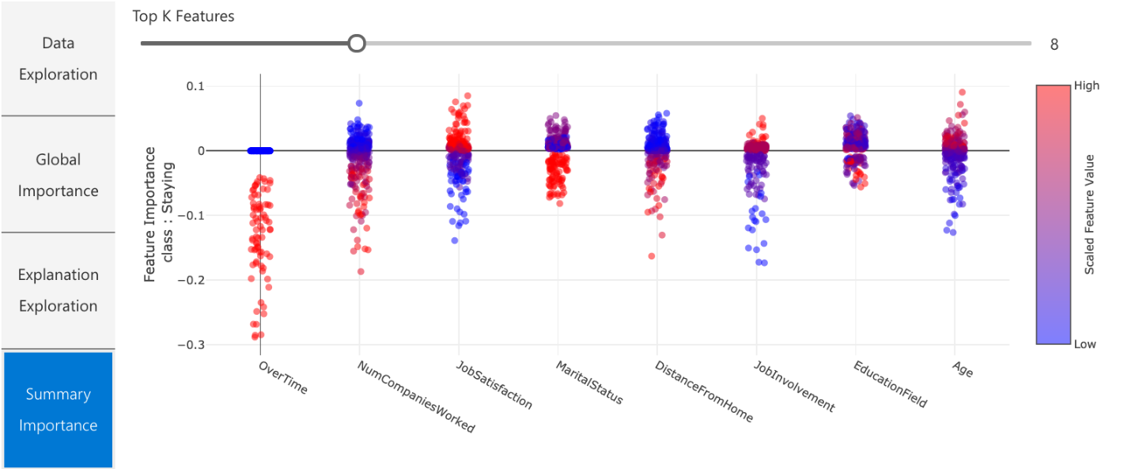
Azure Machine Learning
Trusted ML

Slide 43
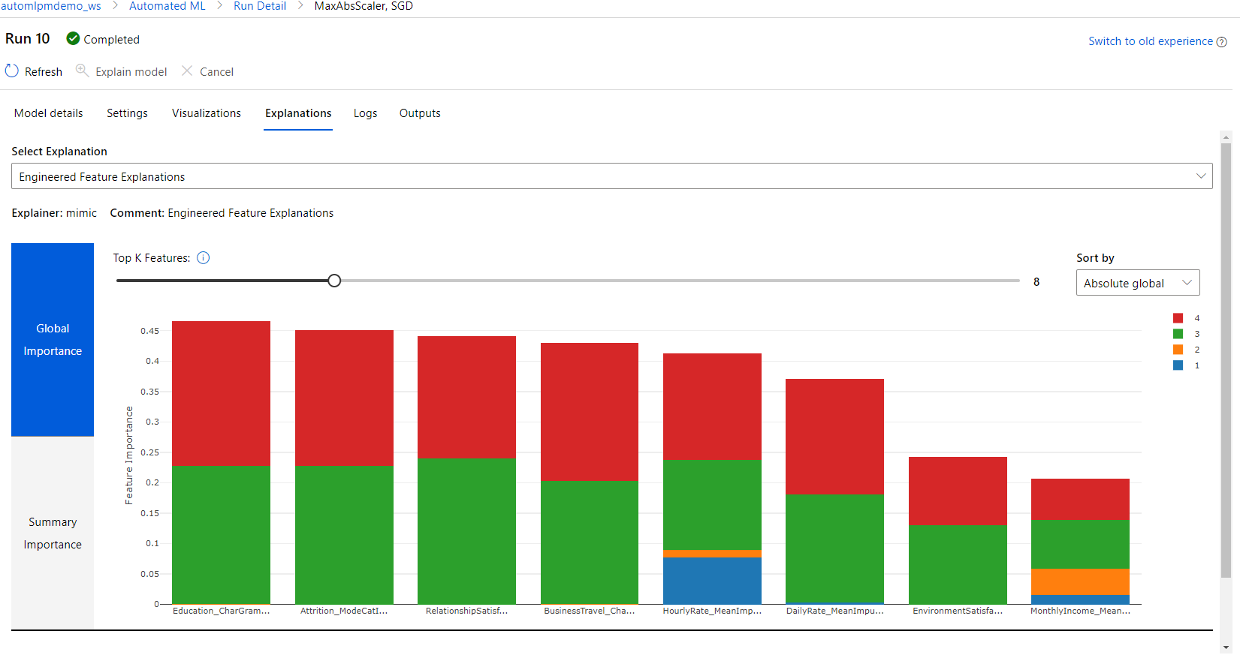
Understanding models and data
with Interpretability
Productive
Managed and secure
Built-in model explanations available at training and inferencing
Glass box and black box explainers for your custom needs
Data understanding, feature importance and local or global explanations for a data point or dataset
Out-of-box visualizations for model predictions and explanations

Slide 44
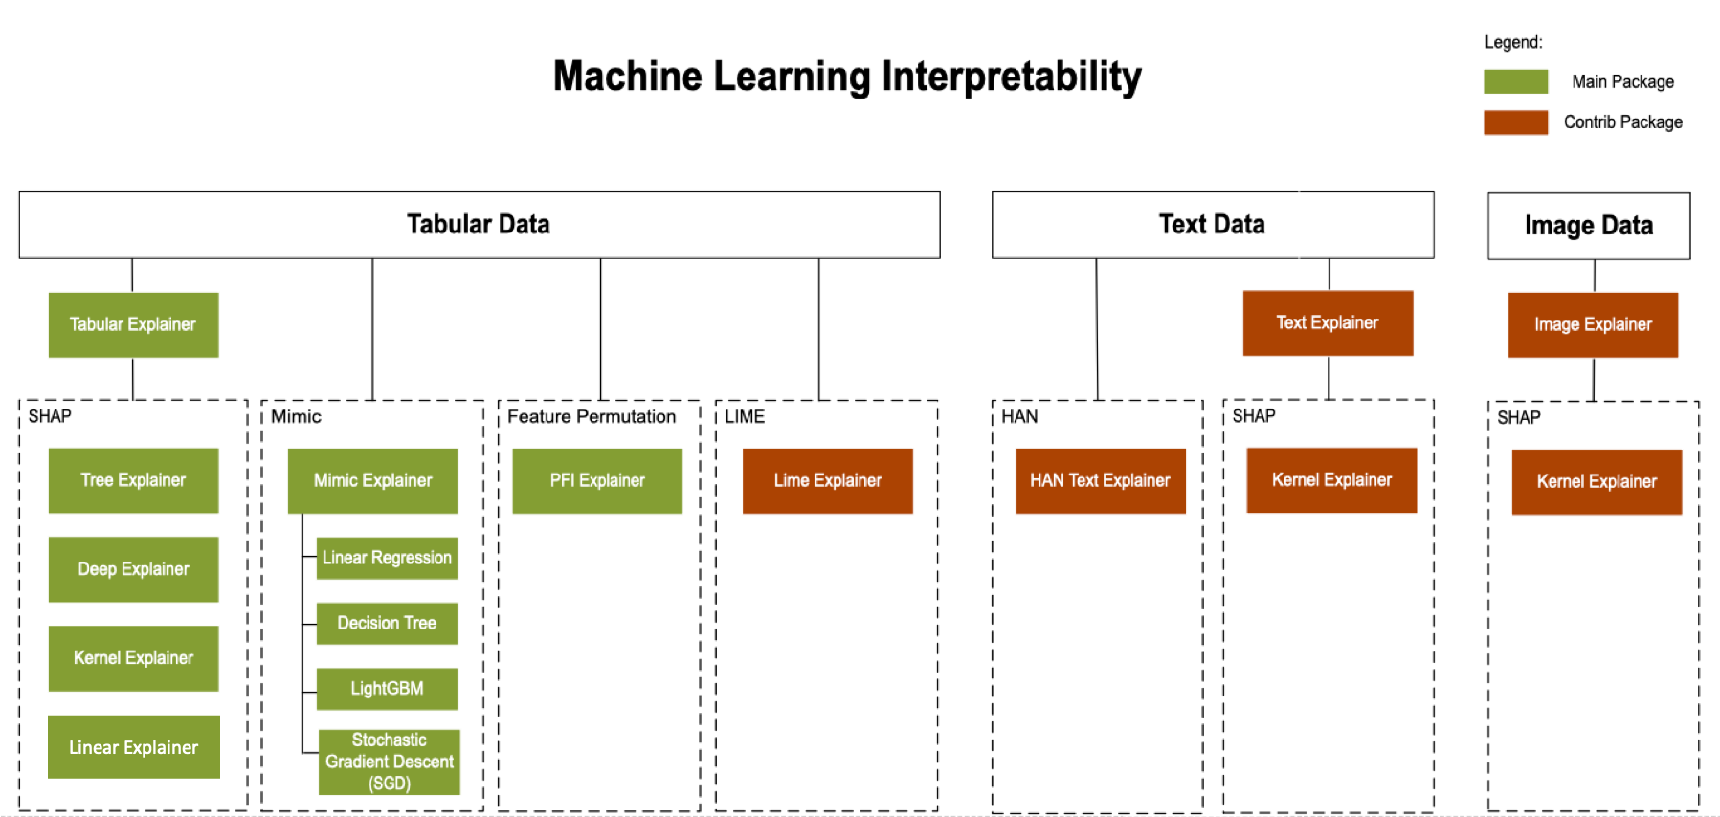
Understanding models and data

Slide 45
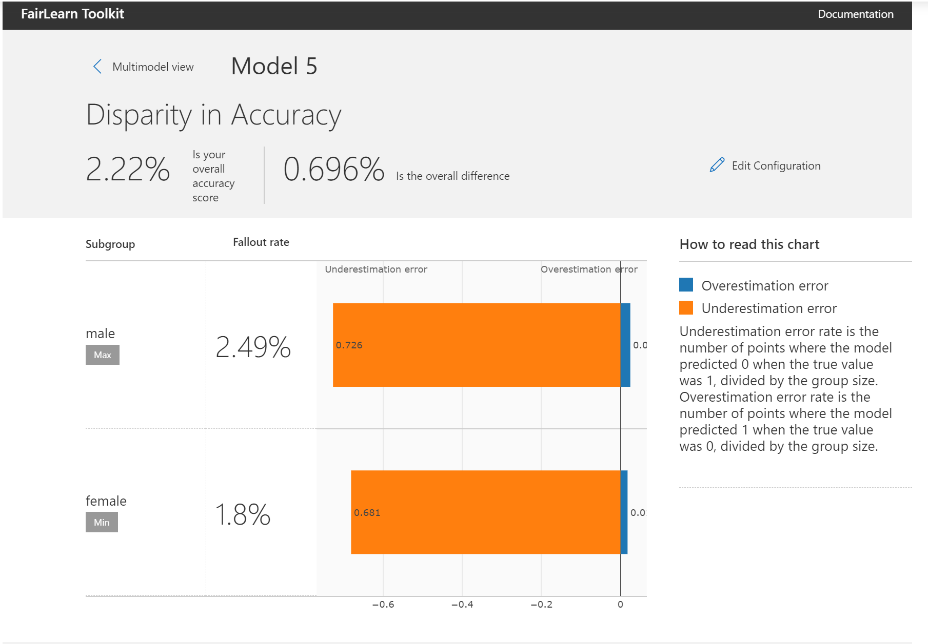
Detect and mitigate unfairness
with FairLearn
Productive
Managed and secure
Open source unfairness assessment and mitigation tools for individual and group
Individual and group fairness metrics to check for bias in datasets and models
Intuitive and configurable set of visualizations to compare before and after fairness performance of a model or make comparisons across models

Slide 46
Demo
Understanding models and data
Notes:
Explainability Demo auf Basis von Azure ML Experiment

Slide 47
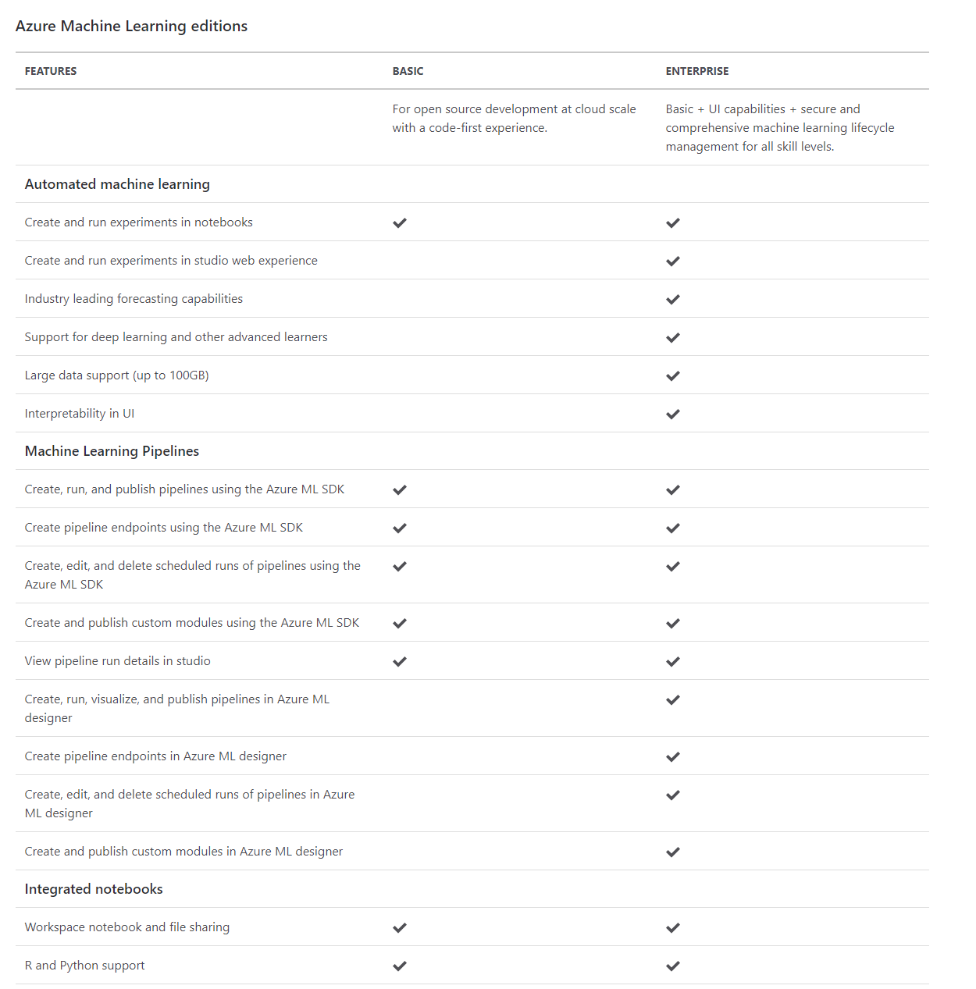
Editions
https://azure.microsoft.com/en-us/pricing/details/machine-learning/
Notes:
https://azure.microsoft.com/en-us/pricing/details/machine-learning/

Slide 48
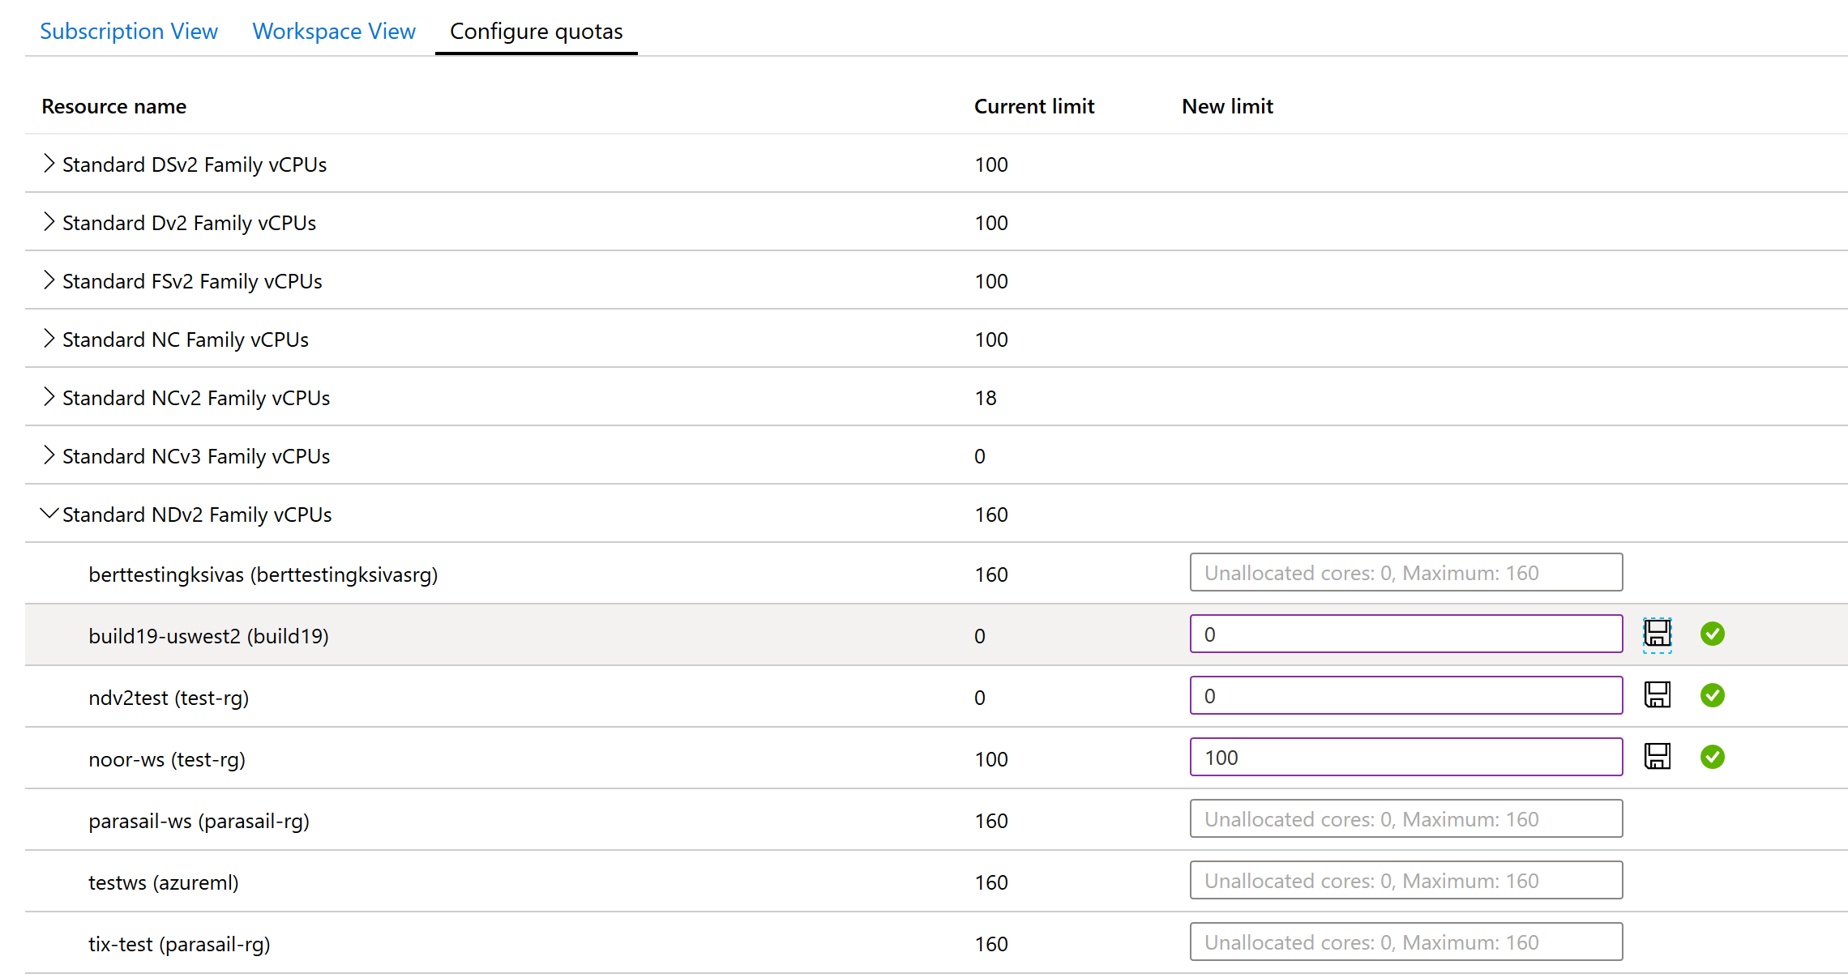
Build enterprise grade ML
with security and governance capabilities
Productive
Managed and secure
Granular RBAC (Role Based Access Controls) give permissions to team members based on operations they can perform
VNET (virtual network) acts as a security boundary, isolating ML resources from the public internet
Scoring endpoint authentication
Capacity management helps with efficient resource distribution, using capacity limits

Slide 49


MLOps
Data Scientist
IT Professional
Model reproducibility
Model validation
Model deployment
Model retraining

Slide 50
DevOps
MLOps
Code reproducibility
Model reproducibility
Code testing
Model validation
App deployment
Model deployment
Model retraining

Slide 51


MLOps with Azure Machine Learning
Collaborate
Build app
Test app
Release app
Monitor app
App developer
using Azure DevOps
Data scientist using
Azure Machine Learning
Model reproducibility
Model validation
Model deployment
Model retraining

Slide 52

MLOps with Azure Machine Learning
Collaborate
Build app
Test app
Release app
Monitor app
App developer
using Azure DevOps
Code, dataset, and environment versioning
Data scientist using
Azure Machine Learning
Model reproducibility
Model validation
Model deployment
Model retraining

Slide 53
MLOps with Azure Machine Learning
Collaborate
Build app
Test app
Release app
Monitor app
App developer
using Azure DevOps
Train model
Validate model
Model validation & profiling
Data scientist using
Azure Machine Learning
Model reproducibility
Model validation
Model deployment
Model retraining

Slide 54
MLOps with Azure Machine Learning
Collaborate
Build app
Test app
Release app
Monitor app
App developer
using Azure DevOps
Train model
Validate model
Deploy model
Model packaging
Simple deployment across cloud and edge
Data scientist using
Azure Machine Learning
Model reproducibility
Model validation
Model deployment
Model retraining

Slide 55
MLOps with Azure Machine Learning
Collaborate
Build app
Test app
Release app
Monitor app
App developer
using Azure DevOps
Train model
Validate model
Deploy model
Monitor model
Model management & monitoring
Data scientist using
Azure Machine Learning
Retrain model
Model performance analysis
Model reproducibility
Model validation
Model deployment
Model retraining

Slide 56


MLOps with Azure Machine Learning
Collaborate
Build app
Test app
Release app
Monitor app
App developer
using Azure DevOps
Train model
Validate model
Deploy model
Monitor model
Azure Machine Learning extension for Azure DevOps
Data scientist using
Azure Machine Learning
Retrain model
Model reproducibility
Model validation
Model deployment
Model retraining

Slide 57
MLOps with Azure Machine Learning
Collaborate
Build app
Test app
Release app
Monitor app
App developer
using Azure DevOps
Train model
Validate model
Deploy model
Monitor model
Audit trail management and model interpretability
Data scientist using
Azure Machine Learning
Retrain model
Model reproducibility
Model validation
Model deployment
Model retraining

Slide 58

Deploy machine learning models at scale
Azure Machine Learning service
Build and Train Models
Train Models
Validate
Deploy Models
Monitor
Containerize and test on Azure Container Instance
Scale with Azure Kubernetes Service
Monitor models with Azure ML
Automated ML
Azure ML Compute
Azure DevOps integration
CI/CD and model retraining

Slide 59
Demo
Deployment auf ACI

Slide 60
Summary

Slide 61


Azure Machine Learning
For all skill levels
Industry leading MLOps
Open & Interoperable
Trusted
Access machine learning for all skills and boost productivity.
Rapidly build and deploy machine learning models using tools that meet your needs regardless of skill level. Use the no-code designer to get started with machine learning or use built-in Jupyter notebooks for a code first experience. Accelerate model creation with the automated machine learning UI and access built-in feature engineering, algorithm selection, and hyperparameter sweeping, to develop high accuracy models.
Operationalize at scale with robust MLOps.
MLOps or DevOps for machine learning, streamlines the machine learning lifecycle, from building models to deployment and management. Use ML pipelines to build repeatable workflows and use a rich model registry to track your assets. Manage production workflows at scale using advanced alerts and automation capabilities. Profile, validate and deploy machine learning models anywhere from the cloud to the edge.
Innovate on an open and interoperable platform.
Take advantage of built-in support for popular open-source tools and frameworks for model training and inferencing. Use familiar frameworks like PyTorch, TensorFlow, scikit-learn and more, or the open and interoperable ONNX format. Choose the development tools that best meet your needs, including popular IDEs, Jupyter notebooks and CLIs or languages like Python and R. After you’ve built and trained your model, use ONNX Runtime to optimize and accelerate inferencing across cloud and edge devices.
Build responsible AI solutions on a secure trusted platform.
Access state-of-the-art technology for fairness and model transparency. Use model interpretability for explanations about predictions, to better understand model behavior. Reduce model bias by applying common fairness metrics, automatically making comparisons and using recommended mitigations. Enterprise-grade security with role based access control, and virtual network support to protect your assets. Audit trail, quota and cost management capabilities for advanced governance and control.
Notes:
All skills: Rapidly build and deploy machine learning models using tools that meet your needs regardless of skill level. Use the no-code designer to get started with machine learning or use built-in Jupyter notebooks for a code first experience. Accelerate model creation with the automated machine learning UI and access built-in feature engineering, algorithm selection, and hyperparameter sweeping, to develop high accuracy models.
ML Ops: MLOps or DevOps for machine learning, streamlines the machine learning lifecycle, from building models to deployment and management. Use ML pipelines to build repeatable workflows and use a rich model registry to track your assets. Manage production workflows at scale using advanced alerts and automation capabilities. Profile, validate and deploy machine learning models anywhere from the cloud to the edge.
Open: Take advantage of built-in support for popular open-source tools and frameworks for model training and inferencing. Use familiar frameworks like PyTorch, TensorFlow, scikit-learn and more, or the open and interoperable ONNX format. Choose the development tools that best meet your needs, including popular IDEs, Jupyter notebooks and CLIs or languages like Python and R. After you’ve built and trained your model, use ONNX Runtime to optimize and accelerate inferencing across cloud and edge devices.
Trusted: Access state-of-the-art technology for fairness and model transparency. Use model interpretability for explanations about predictions, to better understand model behavior. Reduce model bias by applying common fairness metrics, automatically making comparisons and using recommended mitigations. Enterprise-grade security with role based access control, and virtual network support to protect your assets. Audit trail, quota and cost management capabilities for advanced governance and control.

Slide 62
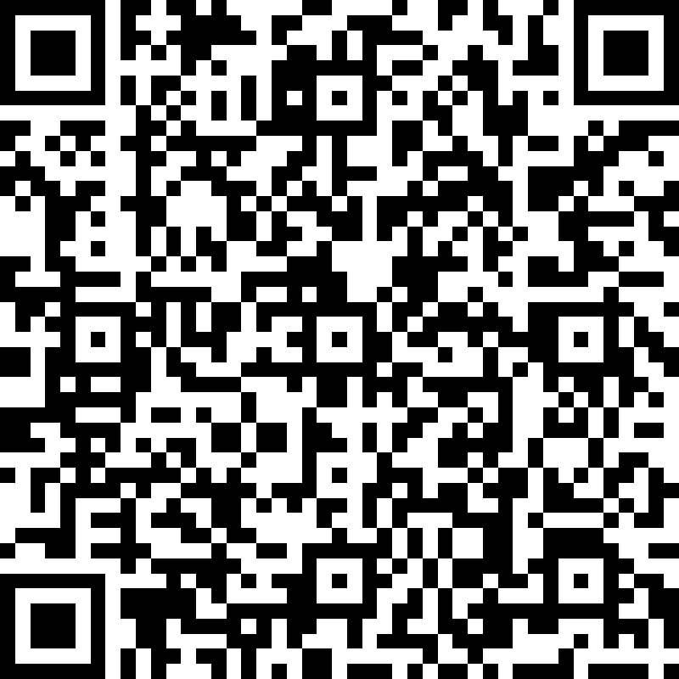
Feedback

Slide 63
Thank you very much for your attention. Vielen Dank für Eure Aufmerksamkeit.

